Slide 1


ONLINE SHOPPING HTML + CSS + PHP + JAVASCRIPT
PROJECT REPORT ON
WEB DEVELOPMENT
Submitted by : CHANPREET SINGH
University roll no : 1311369
Class roll no : 136020
D3-IT A1

Slide 2
USING HTML
What is HTML?
HTML is a markup language for describing web documents (web pages).
HTML stands for Hyper Text Markup Language
A markup language is a set of markup tags
HTML documents are described by HTML tags
Each HTML tag describes different document content

Slide 3
CSS?
Cascading Style Sheets
CSS is a style sheet language used to determine the formatting of an HTML document.
Before we had CSS (and before it was widely adopted) all of this formatting information was embedded directly in the document- either in the form of attributes like width or bgcolor (background color) or in the form of purely presentational tags like font.
Combined with the abuse of the table tag to create complicated layouts, the landscape for layout and design on the web was an unmanageable mess.
CSS fixed all that (kind of.)
Using separate style sheets for an entire site, leveraging semantic markup and identifiers like ids (for unique page elements) and classes (for multiple, like elements) a developer can apply styles across a whole site while updating a single (cacheable) file.
Notes:
CSS is a language used to determine the formatting of an HTML document.
Before we had CSS all of this information was encoded directly into the document.
This was a mess.
CSS fixed all that.
Using separate style sheets for an entire site, leveraging semantic markup and identifiers like ids (for unique page elements) and classes (for multiple, like elements) a developer can apply styles across a whole site while updating a single (cacheable) file.

Slide 4
USING PHP
PHP is a server scripting language, and a powerful tool for making dynamic and interactive Web pages.
PHP is a widely-used, free, and efficient alternative to competitors such as Microsoft's ASP.

Slide 5
The Separation of Style, Content and Behavior
Core Concept of web development
HTML + CSS + JavaScript
Content + Style + Behavior
Notes:
This is the core concept of not just CSS, but web development in general. In a lot of ways it’s taken for granted now, but it wasn’t always so.

Slide 6
Getting the Style Sheet on the Page
<html>
<head>
<meta name="viewport" content="width=device-width, initial-scale=1">
<link href="styles/bootstrap.css" rel="stylesheet">
<link href="fonts/font-awesome.min.css" rel="stylesheet">
<link href="styles/prettyPhoto.css" rel="stylesheet">
<link href="styles/main.css" rel="stylesheet">
<link href="styles/animate.css" rel="stylesheet">
<link href="styles/jquery.dataTables.css" rel="stylesheet">
<link href="styles/bootstrap-datepicker.css" rel="stylesheet”>
<script src="scripts/jquery-2.1.4.js"></script>
<script src="scripts/bootstrap.js"></script>
<script src="scripts/jquery.prettyPhoto.js"></script>
<script src="scripts/jquery.scrollUp.min.js"></script>
<script src="scripts/main.js"></script>
<script src="scripts/jquery.dataTables.js"></script>
<script src="scripts/bootstrap-datepicker.js"></script>
</head>
</html>
Notes:
Simplicity. Especially the HTML 5 example.

Slide 7
DESIGN PHASE
The design phase involves converting the informational, functional, and network requirements identified during the initiation and planning phases into unified design specifications that developers use to script programs during the development phase. Program designs are constructed in various ways. Using a top-down approach, designers first identify and link major program components and interfaces, then expand design layouts as they identify and link smaller subsystems and connections. Using a bottom-up approach, designers first identify and link minor program components and interfaces, then expand design layouts as they identify and link larger systems and connections. Contemporary design techniques often use prototyping tools that build mock-up designs of items such as application screens, database layouts, and system architectures. End users, designers, developers, database managers, and network administrators should review and refine the prototyped designs in an iterative process until they agree on an acceptable design.

Slide 8
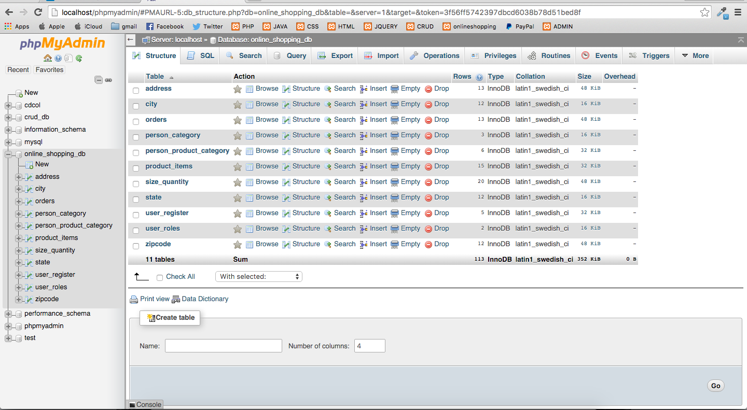
DATABASE TABLES

Slide 9
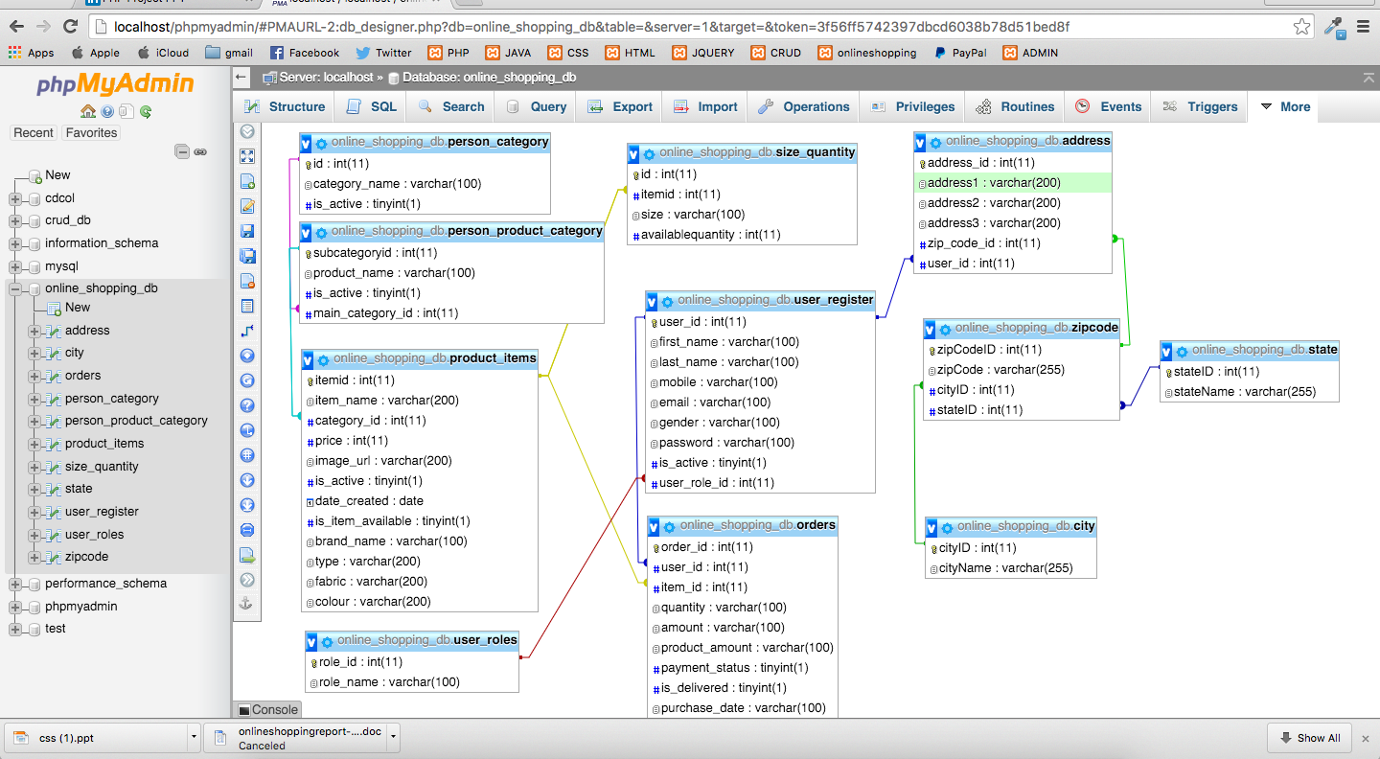
DESIGN PHASE

Slide 10
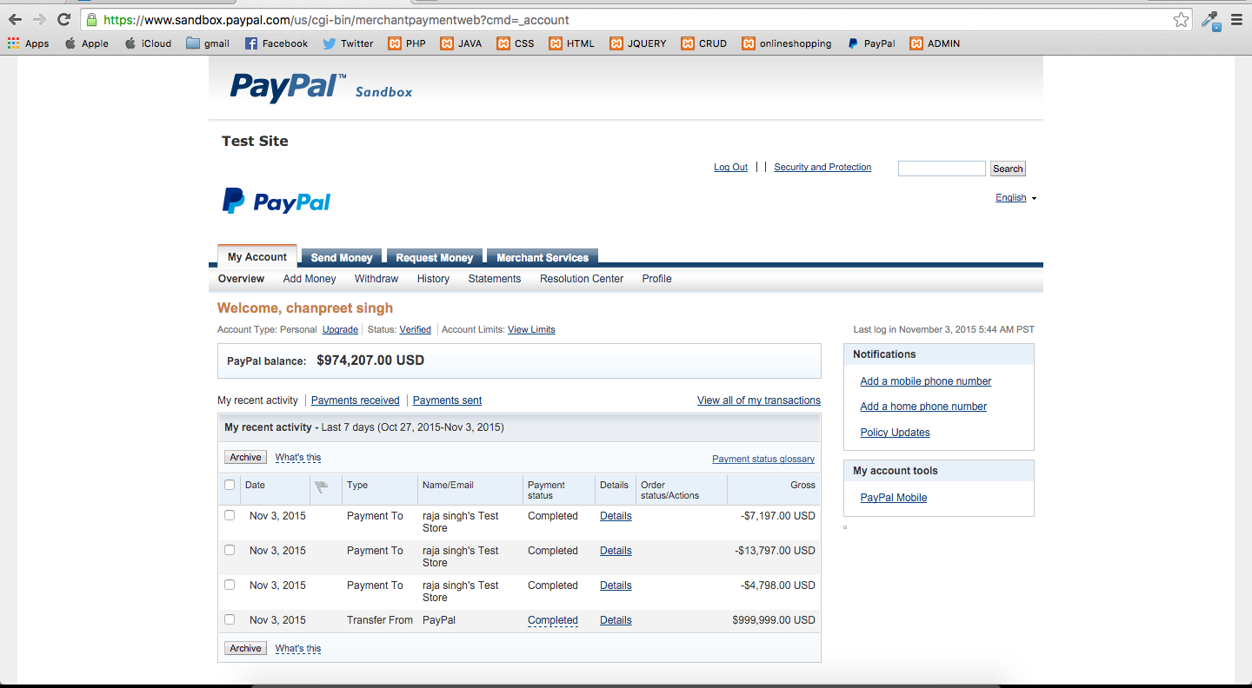
PAYPAL SERVICE

Slide 11
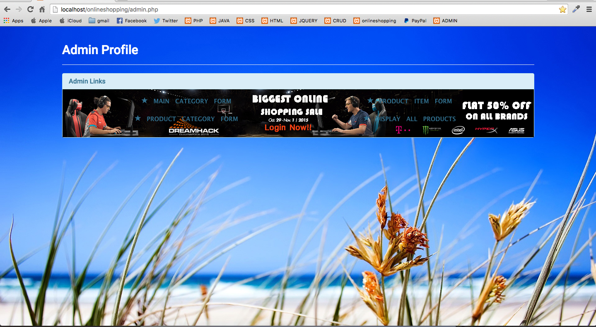
ADMIN PANNEL

Slide 12
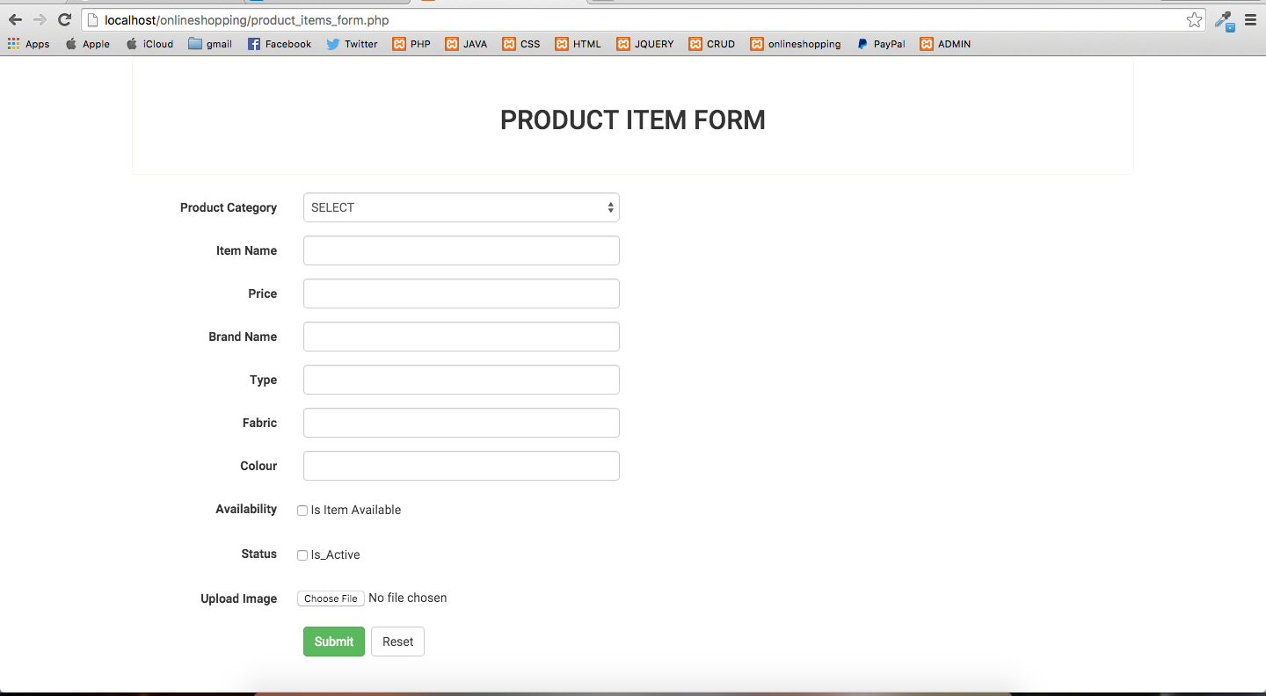
ADDING PRODUCT

Slide 13
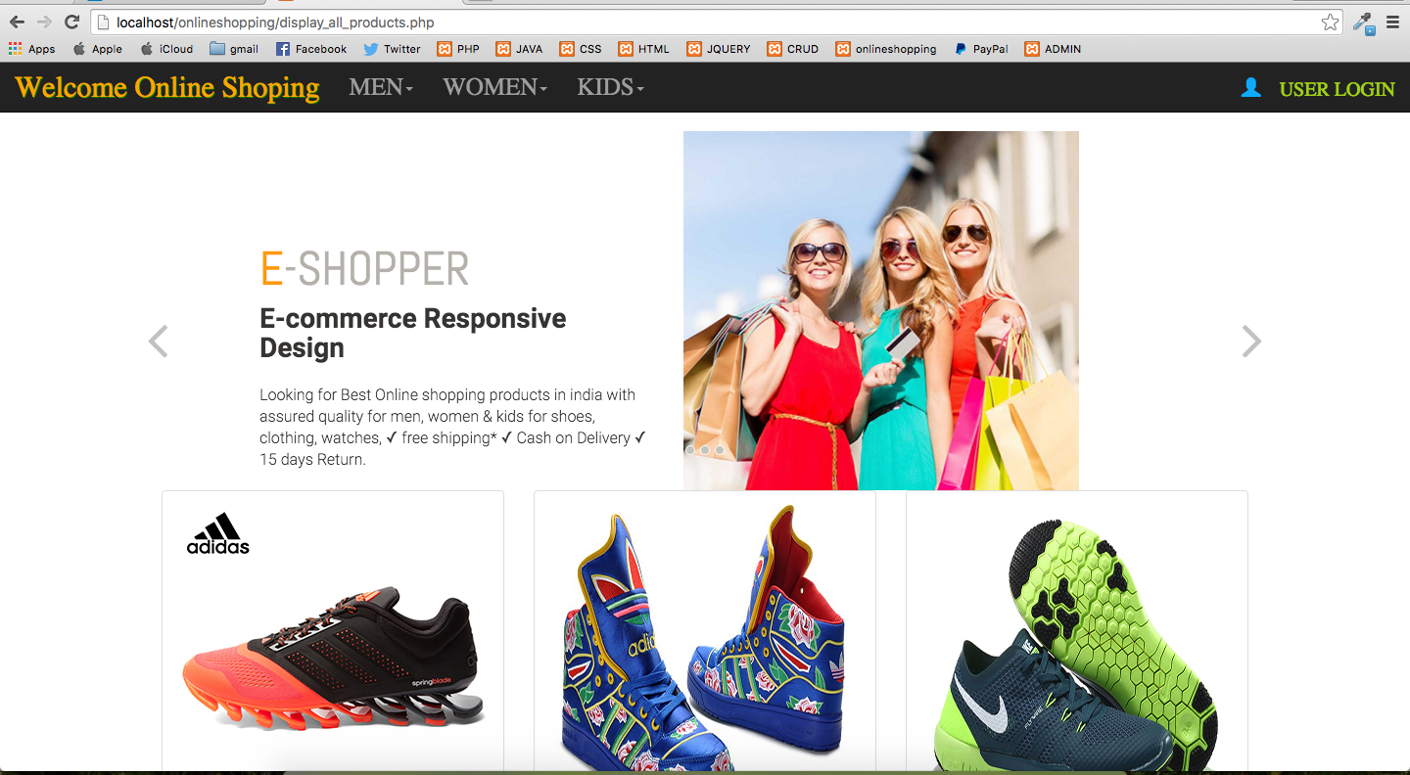
USER INTERFACE

Slide 14
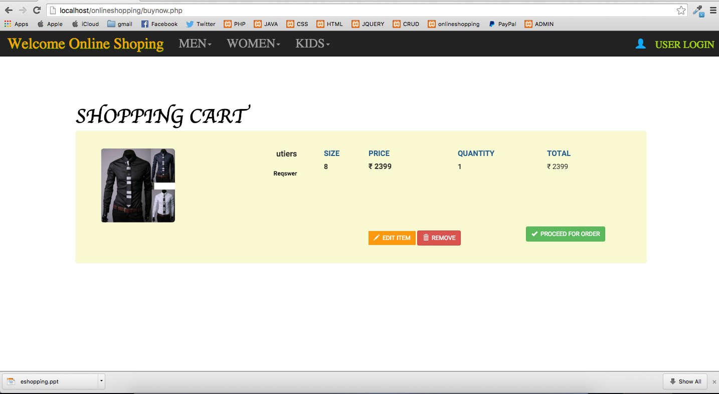
SHOPPING CART

Slide 15
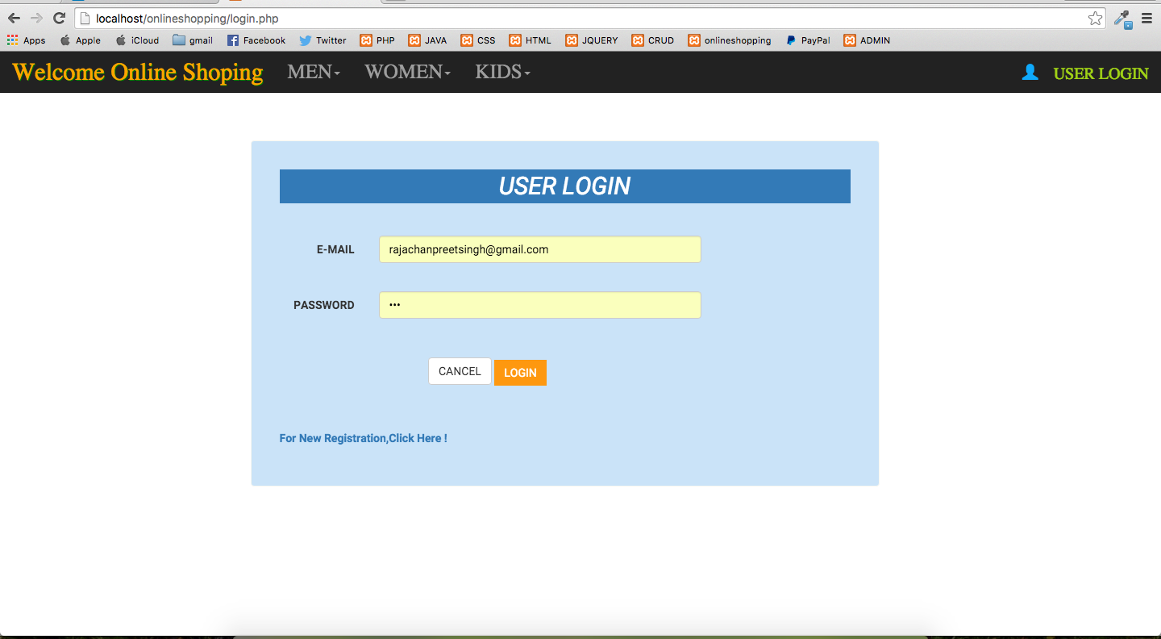
USER ACCOUNT

Slide 16
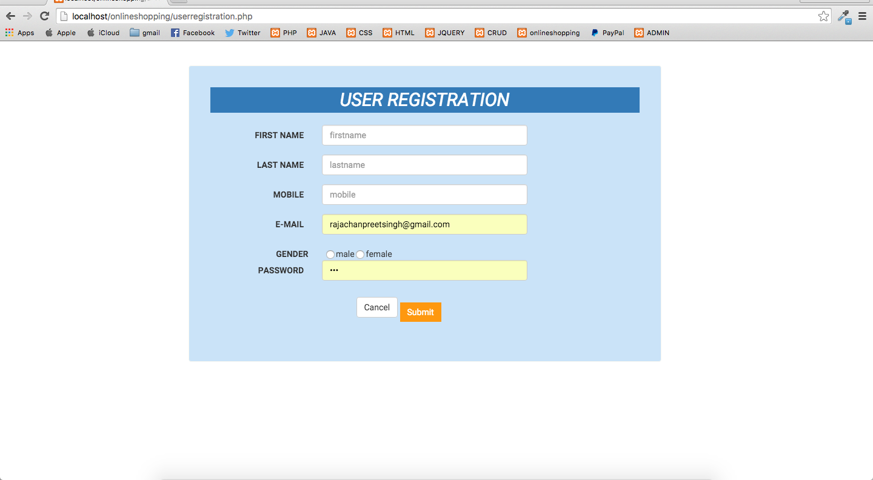
USER REGISTERATION

Slide 17
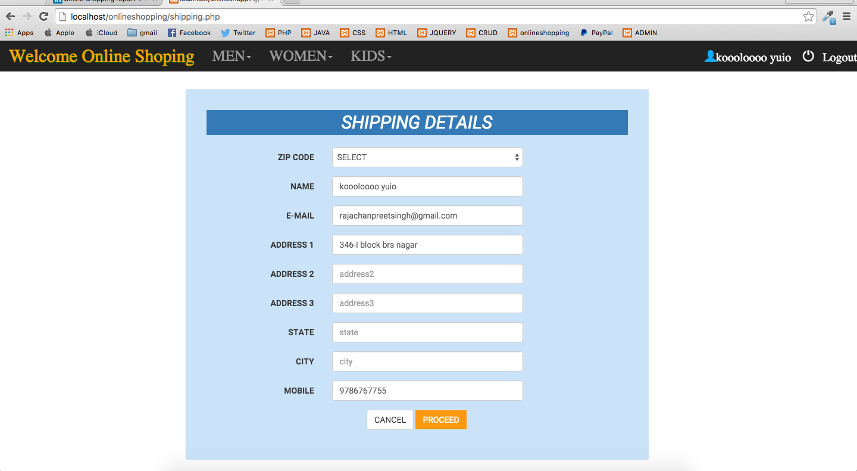
SHIPPING PROCESS

Slide 18
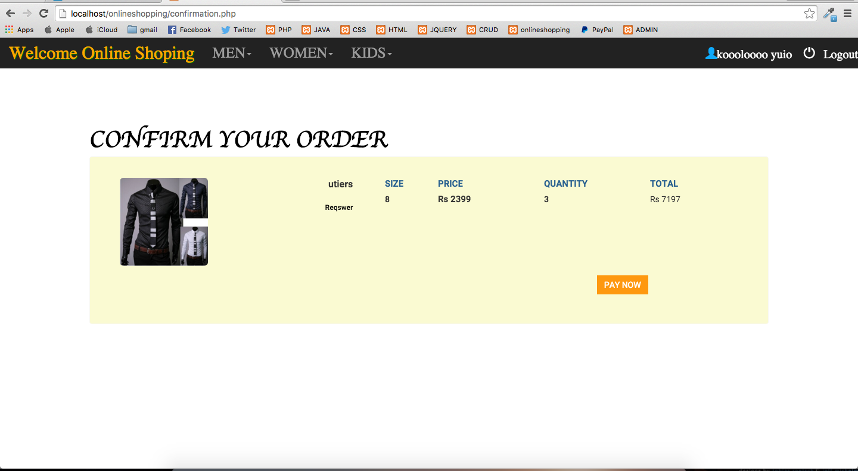
CONFIRMATION

Slide 19
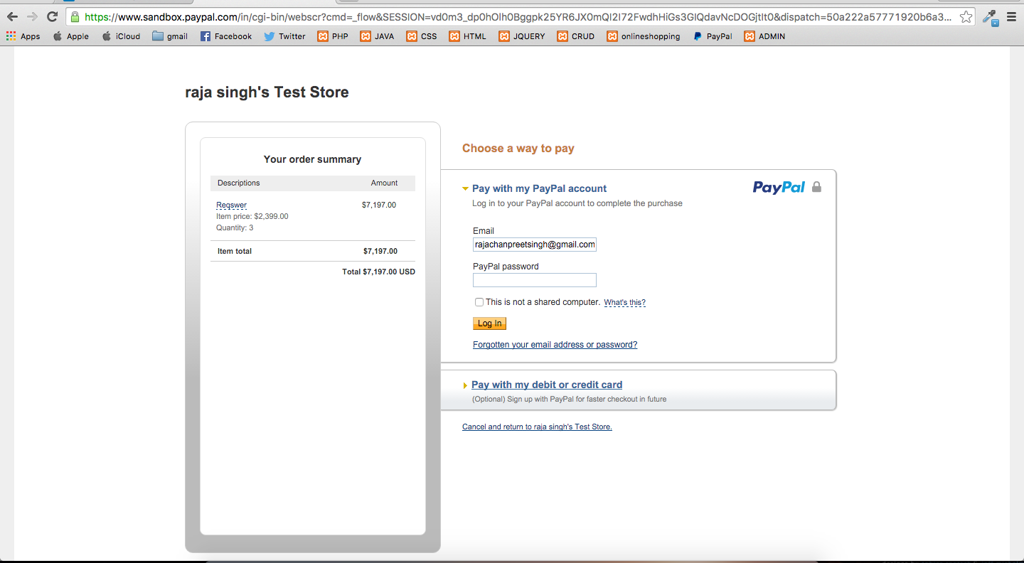
PAYMENT OPTION

Slide 20
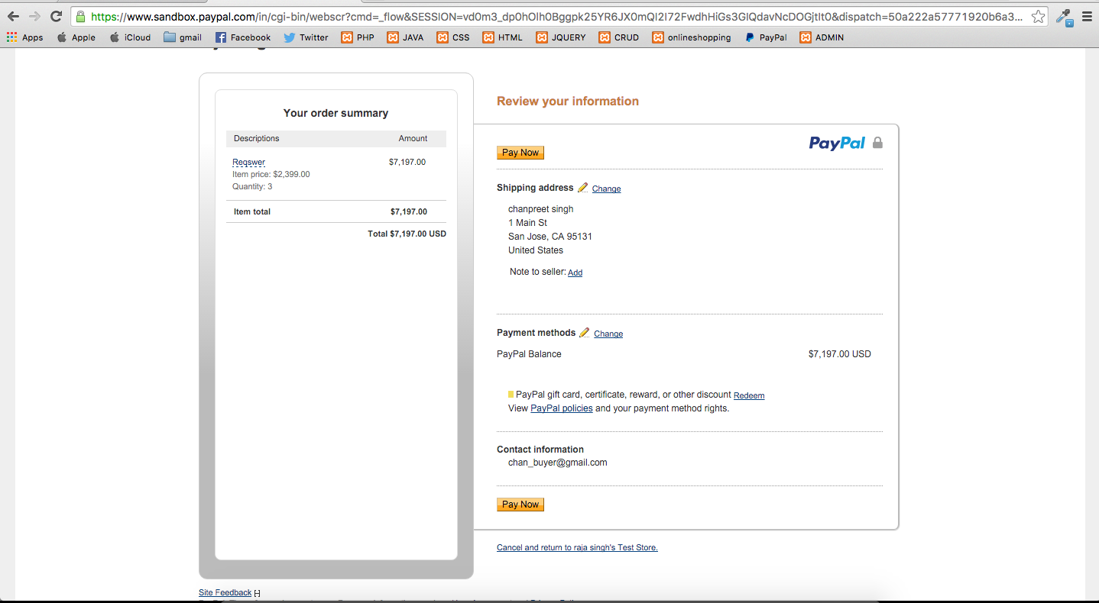
CONFIRMATION OF DETAILS FOR PAYMENT

Slide 21
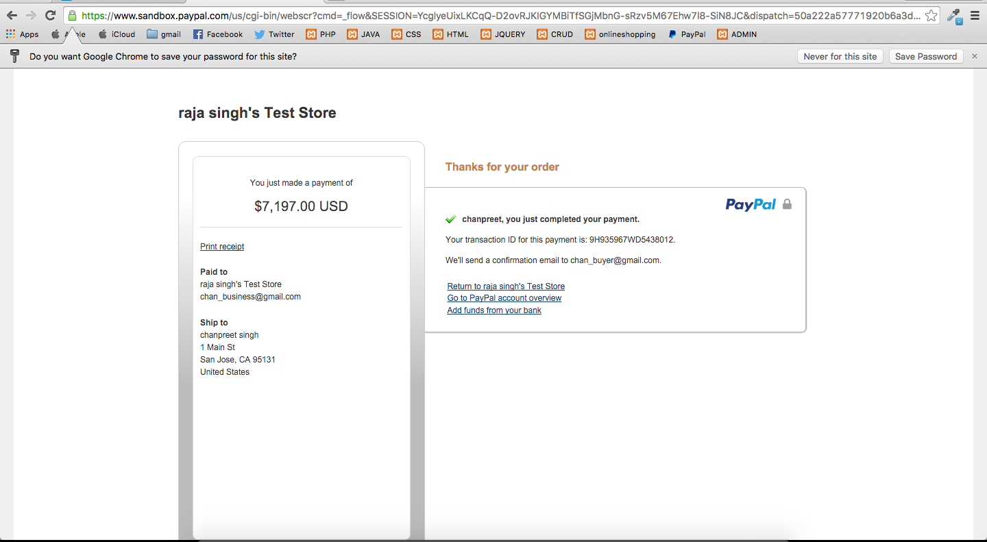
ORDER CONFIRMED

Slide 22
THANK YOU ☺ !!

